Slide 1
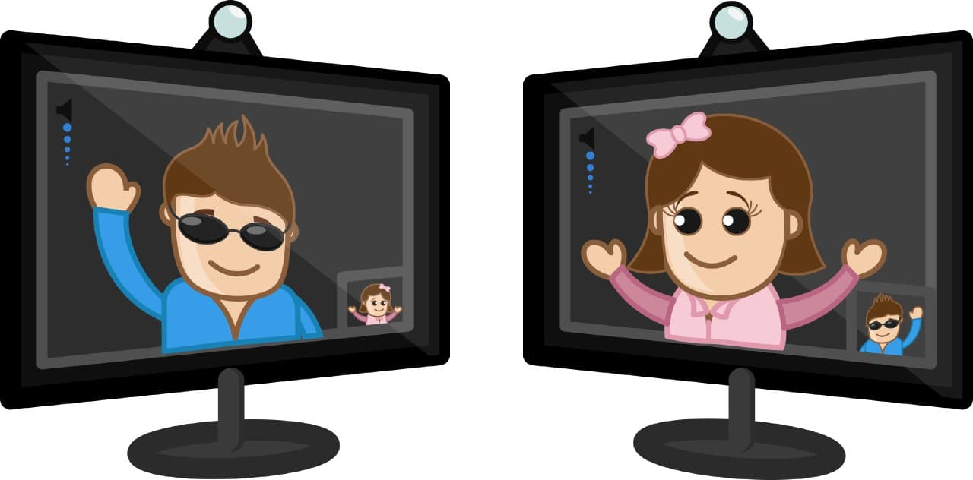
Implementation of Socket Programming using Chat Application

Slide 2
Abstract –
A very simple client-server chat application has been implemented in Java. Its design is described, limitations are discussed, improvements are proposed.
Introduction –
Implementing a chat server application provides a good opportunity for a beginner to design and implement a network.based system. The design is very simple. It is implemented in Java, since is easy to program in, it precludes the need to deal with low level memory management and includes powerful libraries for sockets and threads.

Slide 3
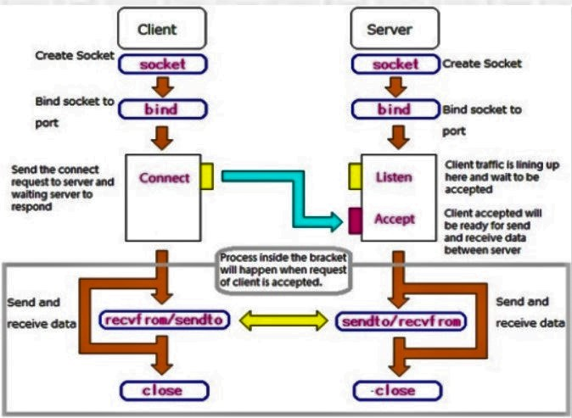
Basic Diagram of Chat Application
Methodology –

Slide 4

Literature Survey –

Slide 5
About TCP/IP Socket Programming:
TCP is a Network Protocol which stands for Transfer Control Protocol, that allows well founded communication between applications.
TCP is consistently used over the Internet Protocol, and that is why referred as TCP/IP. The communication mechanism between two systems, using TCP, can be established using Sockets and is known as Socket Programming.
Hence, socket programming is a concept of Network Programming, that suggests to write programs that are executed across multiple systems, which are connected to each other using a network.

Slide 6
Mechanisms of Socket Programming :
A client creates a socket at it’s end of transmission, and strive to connect the socket to server. When a connection is established, server creates a socket at it’s end and, client and server can now ready communicate through writing and reading methods. Following is the elaborated procedure of what happens when a TCP connection is established:
An object of ServerSocket is instantiated, and desired port number is specified, on which connection is going to take place.
The accept method of ServerSocket is invoked, in order to hold the server in listening mode. This method won’t resume until a client is connected to the server through the given port number.
Now, on client side, an object of Socket is instantiated, and desired port number and IP address is specified for the connection.

Slide 7
4)An attempt is made, for connecting the client to the server using the specified IP address and port number. If attempt is successful, client is provided with a Socket that is capable of communicating to the respective server, with write and read methods. If unsuccessful, desired exception is raised. 5)Since a client is connected to the server, accept method on the server side resumes, providing a Socket that is capable of communicating to the connected client. 6)Once the communication is completed, terminate the sockets on both sides, the server and the client side.
Now, communication is held using input/output streams of Sockets. The InputStream of client is coupled with the OutputStream of server and OutputStream of client is coupled with the InputStream of server. Since, TCP is a two-way network protocol, hence information can flow through both the streams at the time.

Slide 8
Client Side Programming
For the Client machine, we need to now establish the socket connection. Socket Connection is done when the two machines have information about each other’s network location (IP Address) and the TCP port.
Connection: Socket socket = new Socket(IP Address, port number); //IP Address of the server //TCP port Number on which the server is listening
Communication:
The Client is implemented using two threads, one each for incoming and outgoing messages. The main thread opens the socket and connects to the server. It then opens input buffered stream and print writer for incoming and outgoing messages respectively. It also creates a buffered stream to read from the GUI. The main thread takes care of the outgoing message, while another thread deals with incoming messages.

Slide 9
In order to send a message, the user types the message string on the GUI, which is then read into the buffered stream reading from the GUI. The main thread creates the formatted message by adding the destination user name to the beginning of the message string and writes it to the print writer stream. Server(Control messages) have the string “server” as the header.
The reader thread, waits for incoming messages on the buffered stream. When a message arrives, it tokenizes it into the header and the message string and prints <source user> says: <message string> on GUI. Responses from the server are displayed as “server says: <message string>”.
Terminating Communication:
When exit is requested, the client sends exit message to the server, waits for its response, and closes the streams and exits.

Slide 10
Server Side Programming For the server side programming, a ServerSocket is required, that will wait for the client in the listening mode, on a particular TCP port. This ServerSocket holds until a Client Socket is connected successfully. As soon as the client is connected, another Socket comes to the existence that will enable data sharing between the respective client and server. A temporary Socket is created to handle the request from that particular client and our main server socket will be free again, to listen to other requests. Hence we have ServerSocket and Socket on the server side.
Creating ServerSocket:
The ServerSocket is instantiated on a specific port number. Then, the server starts listening for the client requests coming in for that port number. The accept method waits until a client connects to the server. After successful connection, accept returns a Socket that will facilitate the communication.
Communication:
The server is implemented as a singleton class. The main thread opens a server socket on the localhost ip address and port 7807, which has been arbitrarily chosen and hard coded. It then waits for clients to connect to it. When a client connects to the server, it creates a separate thread as well as a User object dedicated to it. The thread dedicated to the client opens a buffered stream to read input messages from the client and a print writer stream to send messages to the client.

Slide 11
The messages going from a client to the server are strings with at least two words separated by a space. The first word is the header, which is the destination username. The messages going from the server to a client are strings with at least two words separated by a space. The first word is the header, which is the source username.
The thread dedicated to the client waits for incoming messages in the input buffered stream, tokenizes the messages into the header and the message string, it attaches a new header displaying the source user name to the beginning of the message string and copies it to the print writer stream of the User object associated with the destination user. If the destination user isn’t online, it sends back an error message to the source client.
Messages destined for the server (control messages) contain the string server as the header. Control messages are sent to know who is online and to exit. In case of the former, the thread dedicated to the user, returns a string containing the online user names to the user.
Terminating Communication :
When exit is requested, the thread closes the streams and the socket associated with the client and exits.

Slide 12
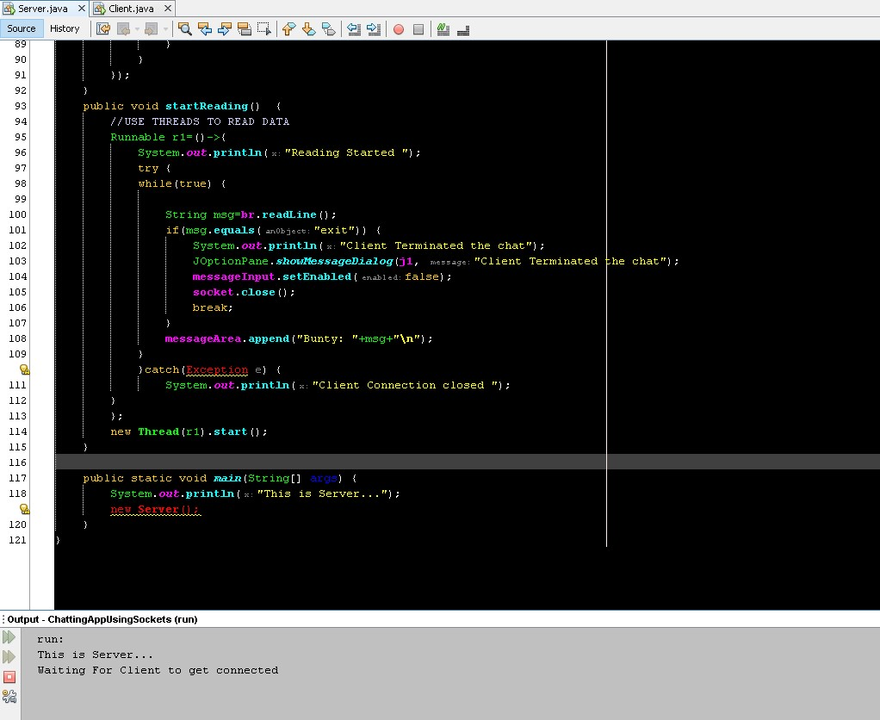
Execution/Result –
Server started the connection and waiting for client to get connected

Slide 13
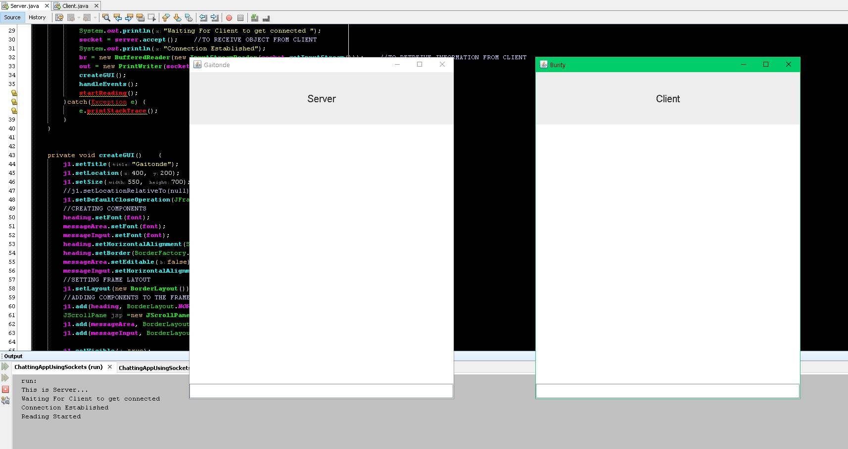
Once the client side is ready, then the connection is established between Client and Server.

Slide 14
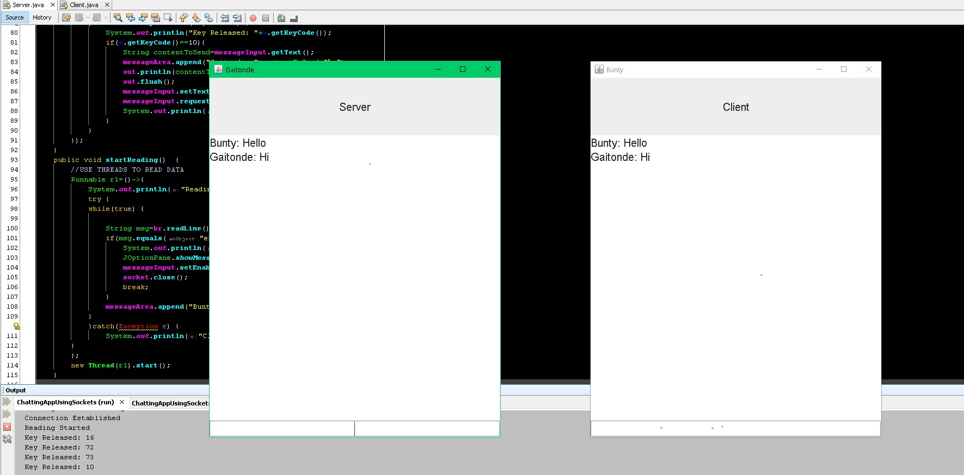
Once the connection is established, we can interact with each other sending messages using ENTER key as shown below

Slide 15
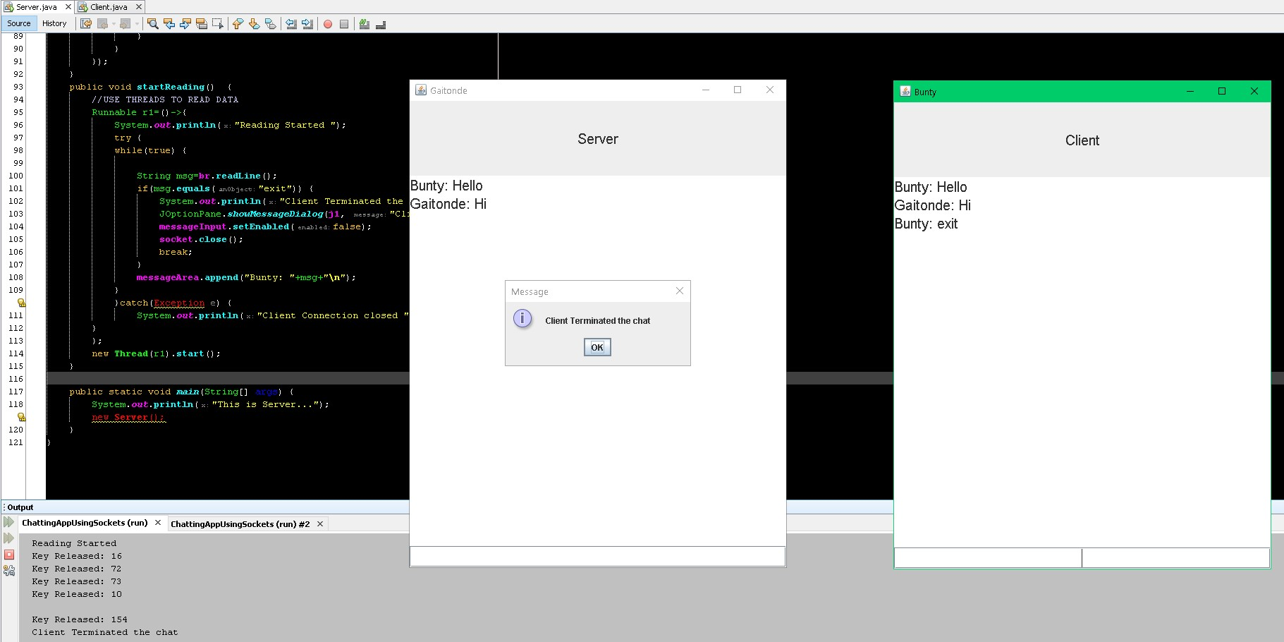
If we type ‘exit’ as seen in client side in messageInput, then on Server side you can see the pop-up message that Client has Terminated the chat.

Slide 16
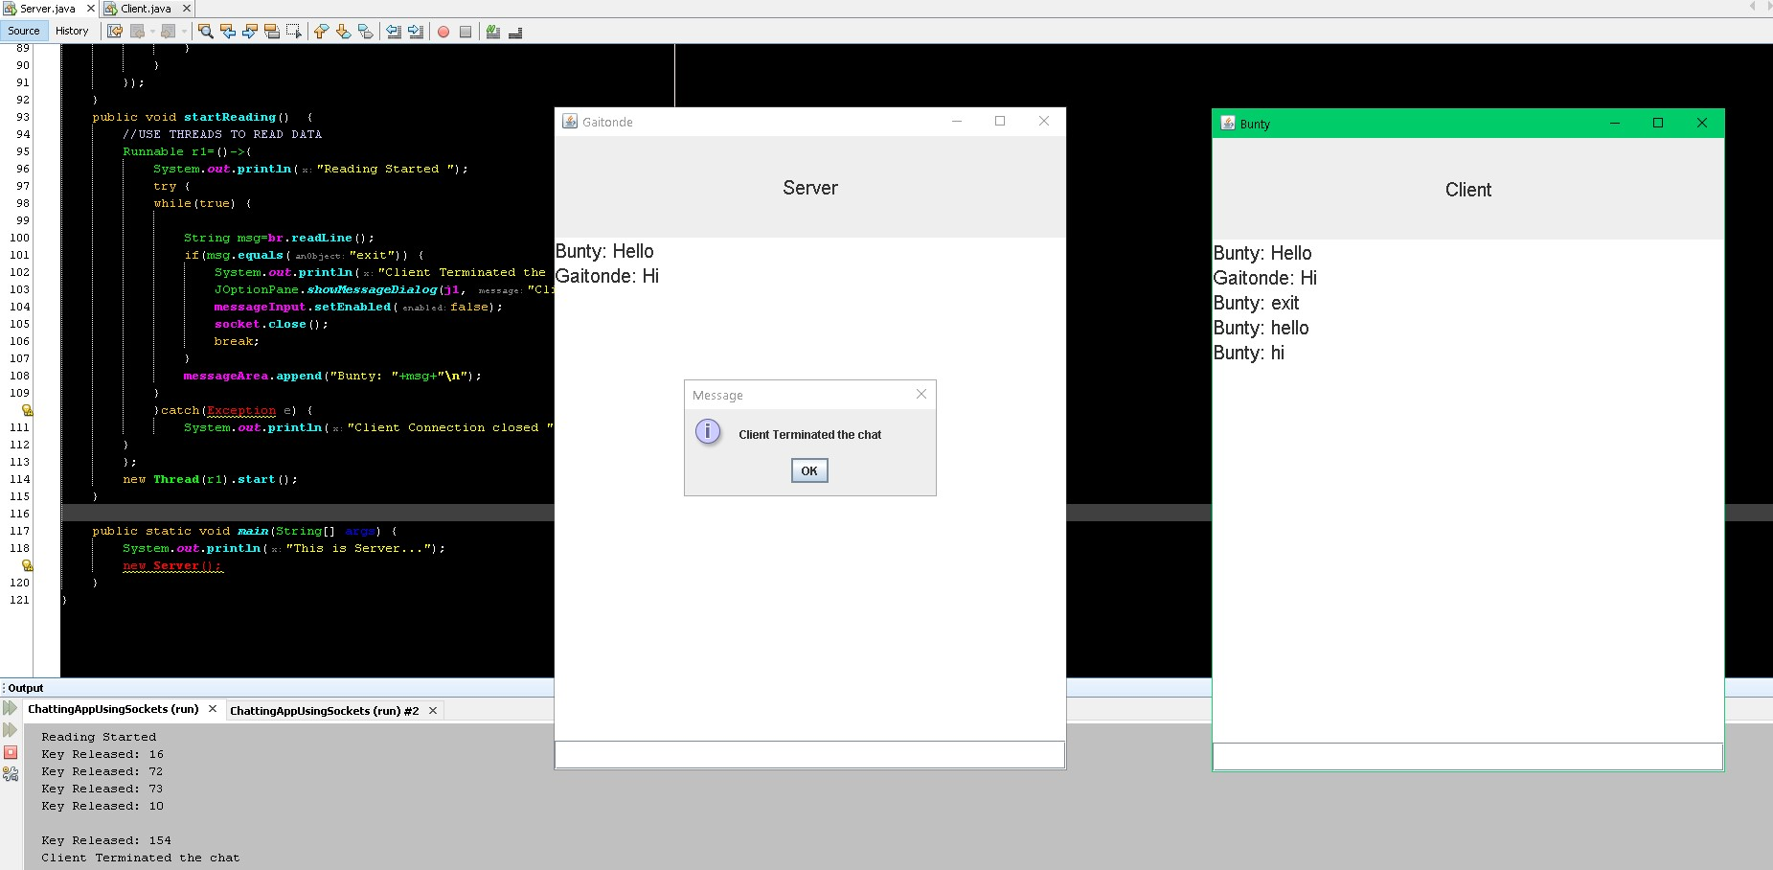
Even if we try to send Hi, Hello after termination of either of the chats, you can see that the message doesn’t reach the Server side once the Client has terminated the chat in this case.

Slide 17
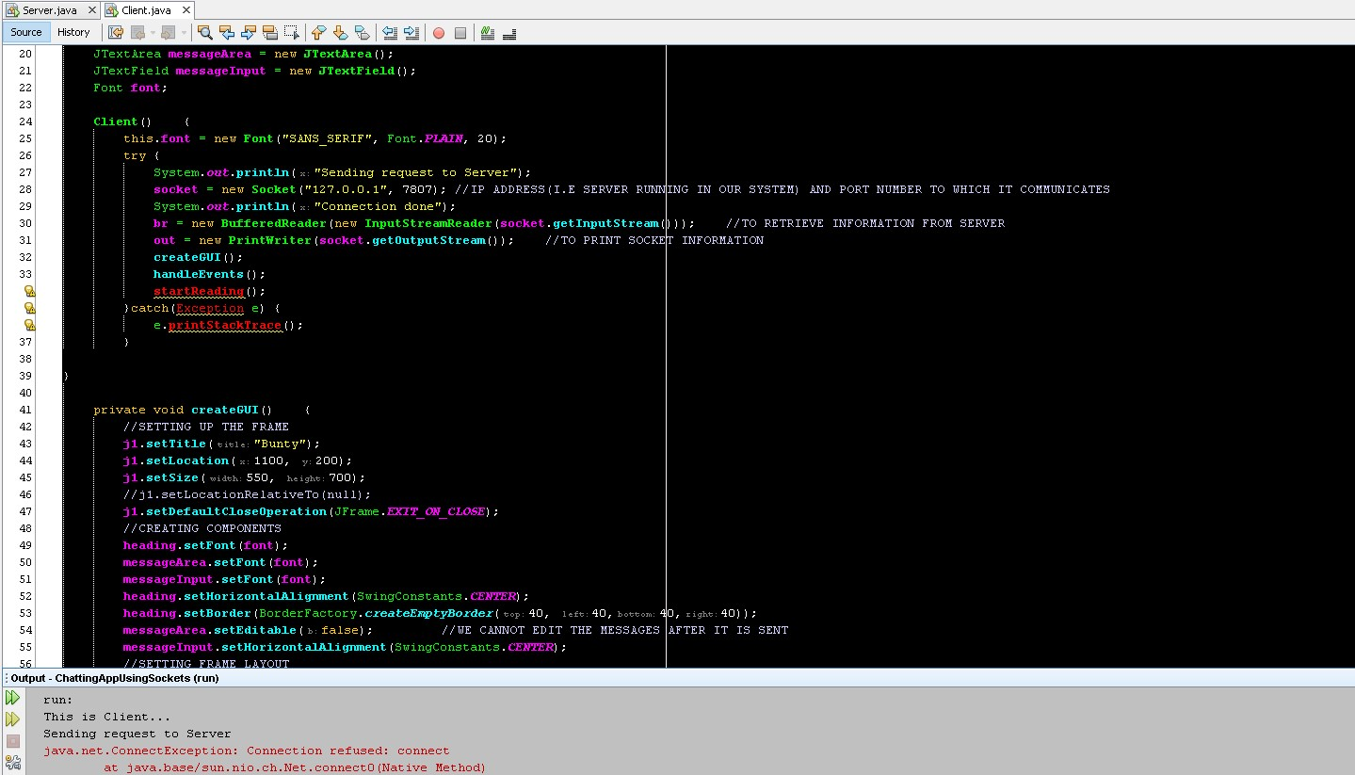
One more case you can see that if you execute Client side, then you will get the Error since we have not run Server program before that, which is necessary before client connection.

Slide 18
Conclusion –
Can be used for private chat over LAN and over Internet.
Can be further developed for file transfer .
Can be used for broadcasting notices in your organization.
It is Secure and Reliable.
Simple and Effective with low memory and resource usage.
No dedicated Server is required if the application is used for LAN, i.e PC can become server.
Basically the application can be for communication purpose anywhere.
For over the internet connection, a dedicated server with global IP will be required.
References –
www.google.com
https://youtu.be/6BePDVZHyc

